Slide 1
YOUR ROVER,
ON AUTOPILOT
The rover software: what it does, the three packages, and how to choose yours
Notes:
Welcome everyone. In the next quarter of an hour I’ll show you the software that can drive your rover for you: what it does, the three packages you can buy, how they differ, and how to get started. By the end you should know which package suits your team, and what to do in your first hour.

Slide 2
One base, two brains to add on
HOW IT IS BUILT
+ Wall follower
+ Maze explorer
Keeps one hand on a wall and follows it round.
Maps the course and searches all of it.
The simulator
Free for every team. Runs your real program on a computer, with your rover and your course.
Basic functions
Movement · distance sensor · colour sensor · setup_check tests
Every package has the basic functions. The two autonomy packages each add one brain on top.
Notes:
The software is built like LEGO. At the bottom are the basic functions: driving, turning, the distance sensor, the colour sensor, and a set of tests called setup_check. Every package has these. On top you can add one brain: the wall follower, or the maze explorer. And next to all of it is the simulator, which every team gets for free, whichever package you buy. It runs your real program on a computer, with a pretend version of your rover on a pretend version of the course.

Slide 3
The three packages side by side
 | Basic functions | Wall follower | Maze explorer
Plans the route | You | The rover | The rover
How | Your list of moves | One hand on the wall | Draws a map, searches it
Patches by walls | If your route passes | Yes | Yes
Patches in the open | If your route passes | Missed | Yes
Colours in order | Yes, you code it | No: as it meets them | Yes: explore(find=…)
Time for a run | Fastest | Medium | Slowest: minutes
Price | [price] | [price] | [price]
Notes:
Here they are side by side. With Basic functions you plan the route; with the other two, the rover does. Basic functions finds a patch only if your route goes over it. The wall follower finds patches along the walls, but it misses patches out in the open floor. The explorer finds patches anywhere it can reach. If the colours must be found in a set order, Basic functions can do that because you write the route, and the explorer can do it with explore(find=…); the wall follower simply reacts to colours in the order it meets them. And the price of that: a hard-coded route is fastest, the wall follower is in the middle, and a full search with the explorer takes minutes. Prices: [read out prices].

Slide 4
You plan the route, it drives it accurately
PACKAGE 1 · BASIC FUNCTIONS
You write the route as a list of moves. The software makes every move exact.
async def my_program():
await drive_forward(60)
await turn_to(WEST)
await drive_to_wall(15)
await turn_to(NORTH)
await drive_forward(80)
Good for
Teams who are confident in the coding, know the course well and want the fastest run.
Watch out
Anything unexpected breaks the plan. Drive up to walls, so small errors do not add up.
60 cm ahead, face west, drive on until 15 cm from the wall, face north, 80 cm more.
Notes:
Package one: Basic functions. You write the route as a list of moves, like this: drive 60 centimetres, face west, drive on until you’re 15 centimetres from the wall, face north, drive 80 more. The software makes every one of those moves accurate. It’s great if you know the course well, and it gives you the fastest run. The catch: anything you didn’t plan for breaks the route. My tip: plan your route along walls. Driving up to a wall corrects the small errors from the moves before it, because the wall is always where it is.

Slide 5
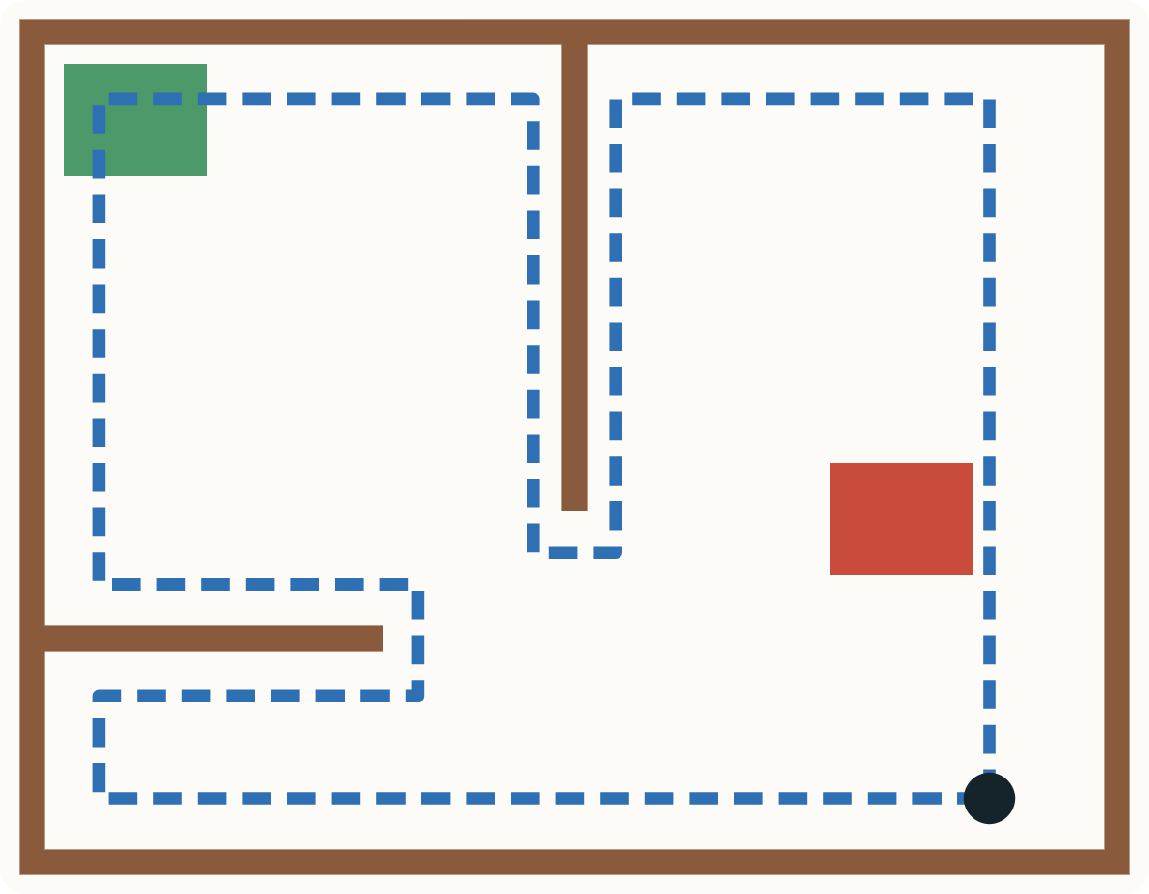
One hand on the wall, all the way round
PACKAGE 2 · WALL FOLLOWER
Drive straight on until there is a wall ahead.
Turn so the wall is on your chosen hand.
At every square, try: towards the hand, straight on, away from the hand, back.
Stop when back at the very first move.
Good for
Simple and predictable. Needs no map. Finds patches next to walls.
Watch out
Misses patches in the open, and walls not joined to the rest.
Blue: the rover’s path (right hand on the wall). It finds the green patch by the wall, and misses the red one in the open.
Notes:
Package two: the wall follower. It works the way you could find your way round a maze in the dark: keep one hand on the wall and keep walking. The rover drives straight on until it meets a wall, turns so the wall is on its chosen hand, and then at every step tries to turn towards that hand, then straight on, then away, then back. It stops when it’s about to repeat its very first move: it has been all the way round. It’s simple, it needs no map, and it’s easy to predict. But look at the picture: it finds the green patch by the wall, and it never goes near the red patch in the middle of the floor. You choose which hand in the settings, so try both in the simulator with your course.

Slide 6
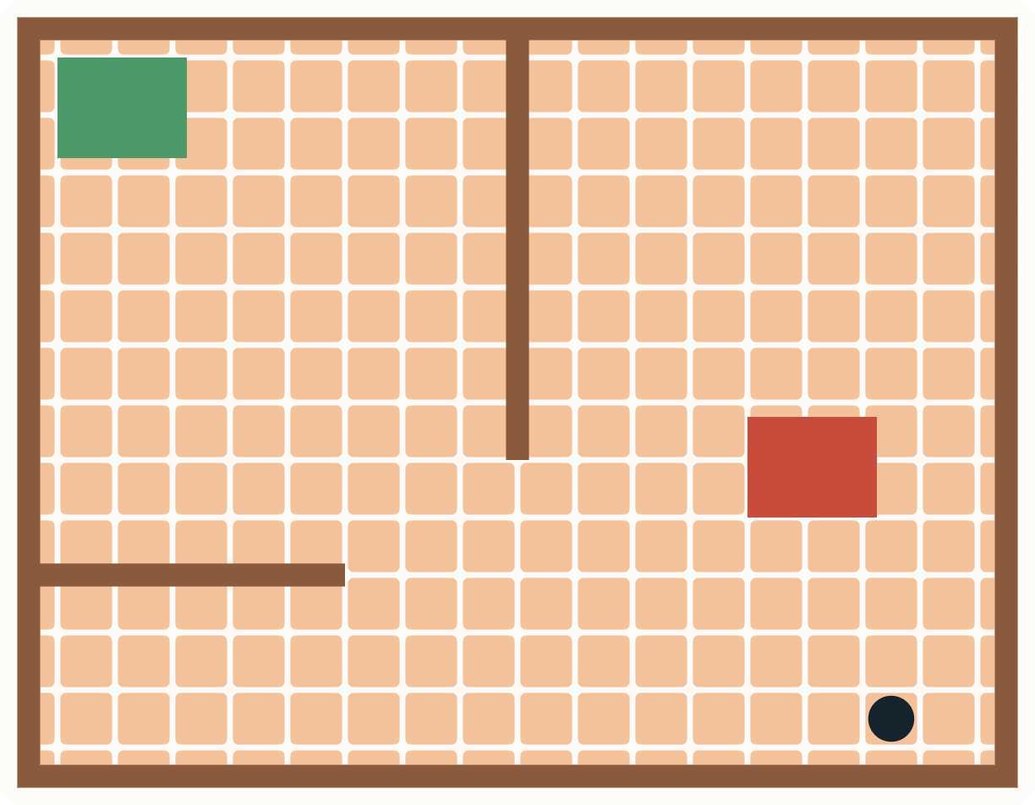
It maps the course and searches all of it
PACKAGE 3 · MAZE EXPLORER
Plan: pick the nearest square not searched yet.
Look: measure ahead; one look maps a whole line.
Move one square, and repeat until done.
await explore(find=color.GREEN,
near=(-30, 110))
Good for
Patches anywhere it can reach. Colours in a set order.
Watch out
Could be slower. Hints help.
Orange squares: floor it has searched. It reaches both patches, but it visits every square to get there.
Notes:
Package three: the maze explorer. The rover thinks of the floor as a grid of small squares, and draws a map as it goes. Over and over, it plans: which is the nearest square I haven’t searched yet? It looks: one measurement with the distance sensor maps a whole line of squares. And it moves one square. It keeps going until it has searched everywhere it can reach. So it finds patches anywhere, even in the middle of the floor. It can also find colours in a set order: explore with find equals GREEN stops on green, does your actions, and then you can explore for the next colour. The cost is time: a full search takes minutes. You can give it hints, like near equals minus 30, 110, meaning roughly 30 centimetres left and 110 ahead, so it searches there first.

Slide 7
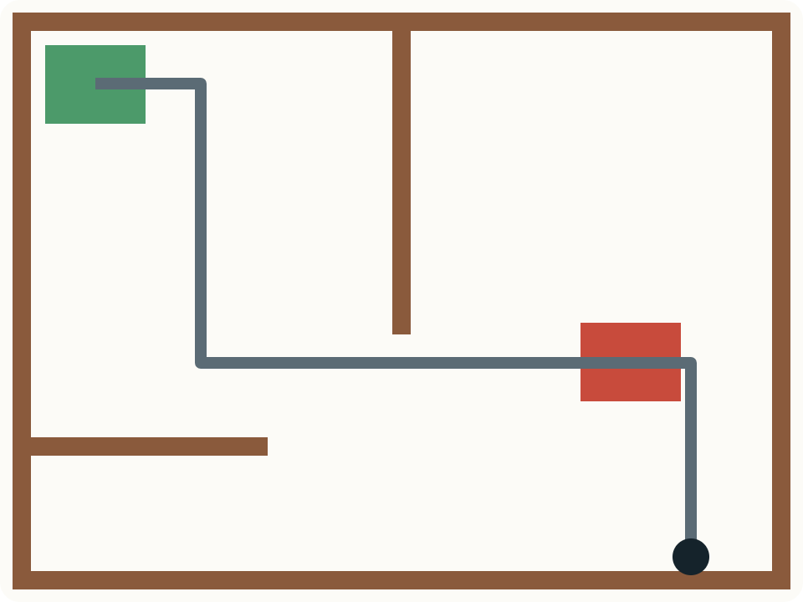
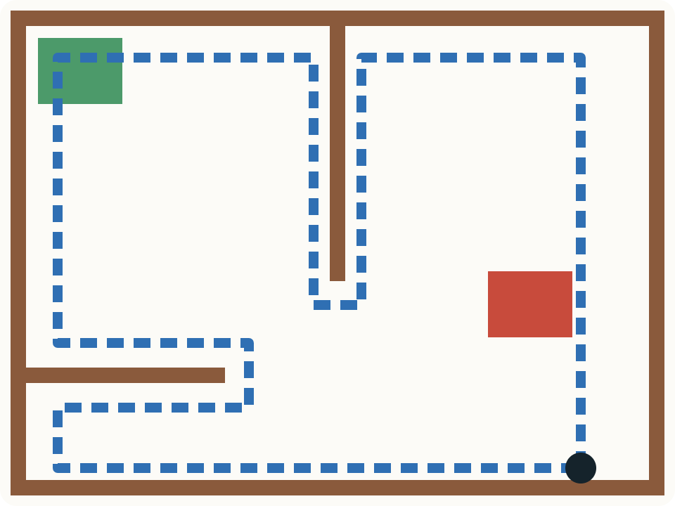
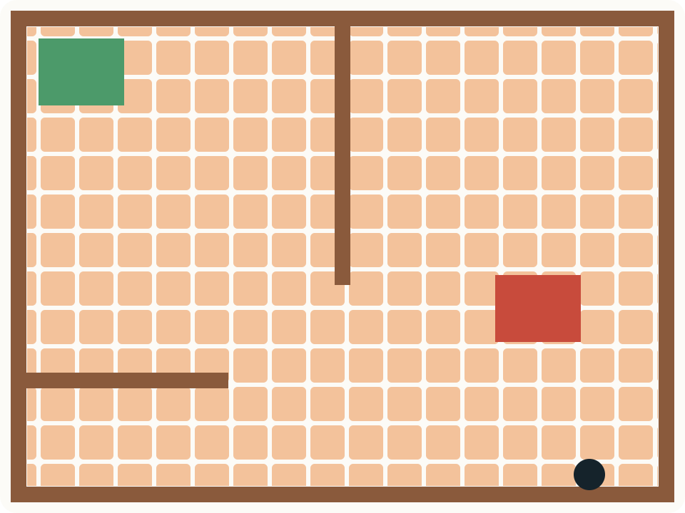
Same course, three ways round
Basic functions
Wall follower
Maze explorer
Exactly the route you planned. Finds both, if you know where they are.
Follows the walls. Finds green by the wall; misses red in the open.
Searches every square it can reach. Finds both, but may take the longest.
Notes:
Here are all three on the same course. With Basic functions, the rover goes exactly where you planned. It finds both patches, but only because you knew where they were. The wall follower goes round the walls: it finds the green patch in the corner and never reaches the red one in the middle. The explorer covers every square it can reach, so it finds both, but it takes the longest. None of them is the best. The best one depends on your course and on how sure you are about where the patches are.

Slide 8
Which one suits your team?
“We know exactly where every patch is, and we want the fastest run.”
Basic functions
“The patches are along the walls, and we want autonomy points with little risk.”
Wall follower
“The patches could be anywhere, or must be found in a set order.”
Maze explorer
With every package you can still write your own moves, before, after or around the autonomy. And remember: it comes out of your budget.
Notes:
So how do you choose? Ask yourselves three questions. Do we know exactly where every patch is, and do we just want the fastest run? Then Basic functions. Are the patches along the walls, and do we want autonomy points without much risk? Then the wall follower. Could the patches be anywhere, or must they be found in a set order? Then the maze explorer. Two more things. Whichever you choose, you can still write your own moves, before, after or around the autonomy: for example, drive to a good starting point and then hand over. And the software is part of your budget, so weigh it against what else you could spend that money on.

Slide 9




Every package comes with
WHICHEVER YOU CHOOSE
setup_check: 8 tests
The simulator, free
Finds wrong settings before they waste your time, and tells you the fix.
Test your program on a computer before you test it on the floor.
A user manual
Room for your own code
A first-hour checklist, and every setting and function explained.
Your own program, and your own actions for each colour.
Notes:
Whichever package you choose, you get four things. setup_check: eight tests that check every part of your rover, one at a time, and tell you exactly which setting to change. The simulator, for free. A user manual, with a checklist for your first hour and every setting and function explained. And room for your own code: your own program, and your own actions for what the rover does on each colour, like dropping a payload.

Slide 10
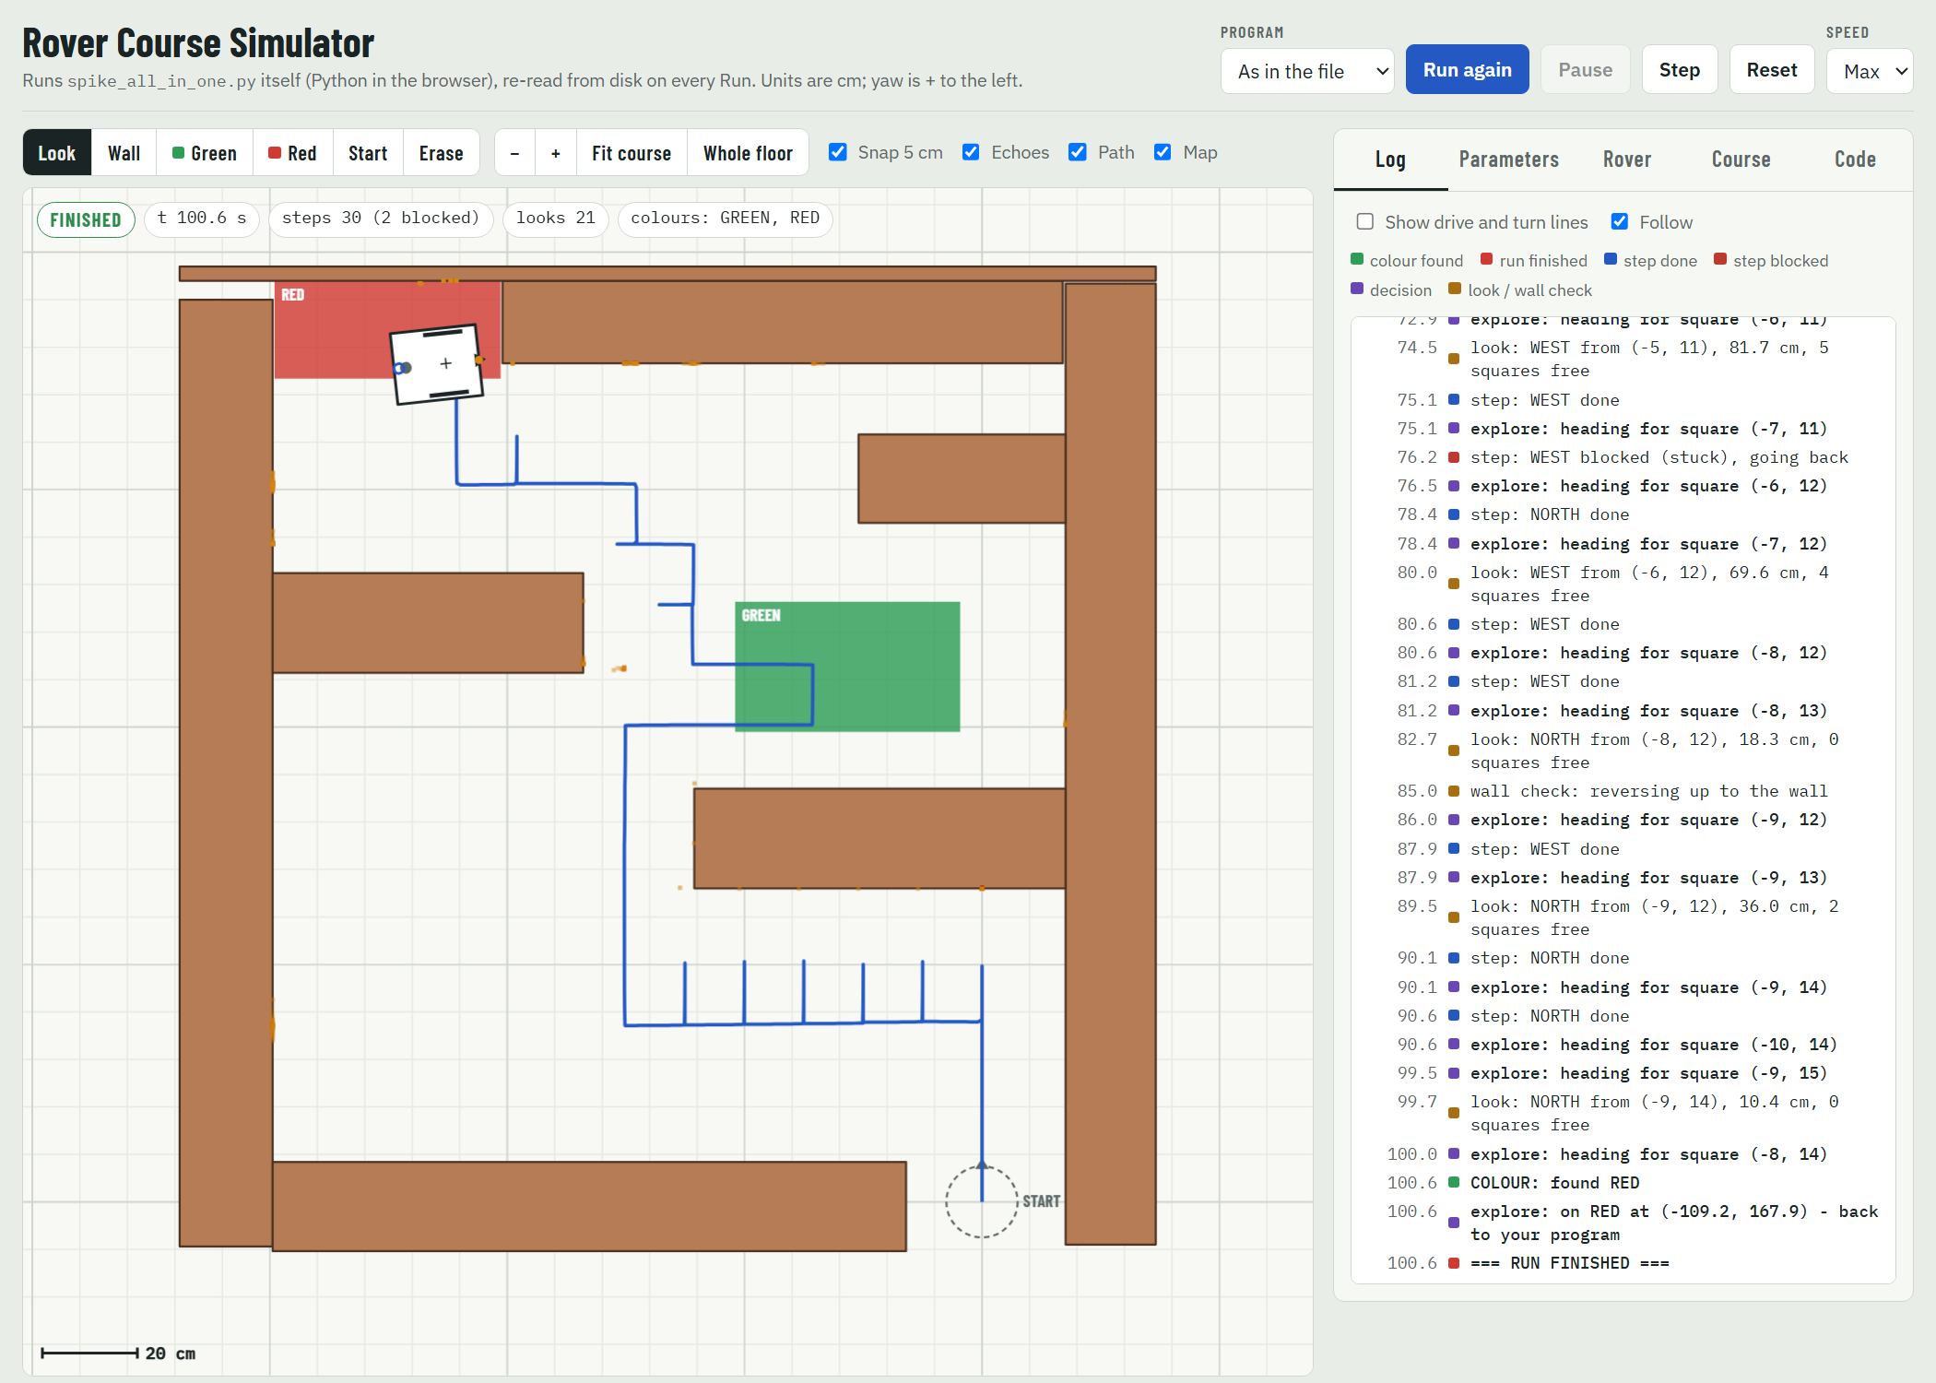
The simulator: test on a computer first
Your real program
The same file you put on the hub. Save it, press Run.
Your rover, your course
Draw both: wheels, sensors, walls and patches.
See what it thought
Every message, and where the rover was at that moment.
Catches wrong settings
A red warning when your settings don’t match your rover.
Notes:
This is the simulator. It runs your real program file, the same one you put on the hub, with a pretend rover on a pretend course. You draw your rover, its wheels and sensors, and your course, its walls and patches. When you run, you see the rover’s path, and a log of everything the program printed. Click any line and the simulator shows you where the rover was at that moment. And if the settings in your program don’t match the rover you drew, you get a red warning. That one matters: in one of our tests, a rover running with the wrong wheel size got completely lost. The simulator is a model, so always test on the real rover too, but it saves you hours on the floor.

Slide 11
Design your rover for the software
BEFORE YOU BUILD
It should turn on the spot (skid steer)
Think about size
Driven wheels on both sides. A rover that steers like a car cannot run the autonomy as it is.
Spinning needs a clear circle: about 27 cm across for a 15 × 18 cm rover. Can your rover get through the gaps?
Four wheels work too
Sensors in the right place
They slide when turning, so turns may be slower. Two quick tests measure it for the simulator.
Distance sensor straight ahead, level with the walls. Colour sensor facing the floor, close to it.
Notes:
A word about design, before you build. The software turns the rover on the spot, by running one side forwards and the other backwards. So you need driven wheels on both sides; a rover that steers like a car can’t run the autonomy. When the rover spins, its corners sweep a circle: about 27 centimetres across for a rover 15 by 18. Gaps narrower than that are no-go zones, so a compact rover gets through more of the course. Four or six wheels work fine; they slide a bit when turning, so turns are slower, and two of the setup tests measure that for the simulator. And put the sensors where they can do their job: the distance sensor pointing straight ahead at the walls, and the colour sensor facing the floor, close to it.

Slide 12
Your first hour, in six steps
GETTING STARTED
1
Copy your file into the SPIKE App
2
Fill in the SETTINGS for your rover
3
Draw your rover in the simulator
4
Run setup_check on the real rover
5
Run your program in the simulator
6
Then run it on the floor
Keep one master copy of your file. Change it, test it in the simulator, then copy it into the SPIKE App.
Notes:
Here’s your first hour, and it’s in the manual too. One: copy your file into a new Python project in the SPIKE App. Two: fill in the settings for your rover: ports, wheel size, where the sensors are. Three: draw your rover in the simulator; it tells you if your settings don’t match. Four: run setup_check on the real rover, and fix whatever it reports. Five: run your program in the simulator. Six: only then, run it on the floor. One tip that will save you a lot of trouble: keep one master copy of your program file. Change it, test it in the simulator, then copy it into the SPIKE App. If you change it in the SPIKE App, copy it straight back, or you’ll end up with two versions.

Slide 13
Start with three places
YOUR PROGRAM FILE
NEAR THE TOP
AT THE VERY BOTTOM
SEARCH THE FILE
SETTINGS
YOUR PROGRAM
on_colour_found
Describe your rover and your course: ports, wheel size, sensor positions.
Choose what runs, or write your own moves.
Your actions on each colour. Look for ADD YOUR OWN ACTIONS HERE.
Tinkering is encouraged - it helps to understand how it works.
Notes:
Your program file is long, over a thousand lines, but don’t panic: to get your rover going, you only need to change three places. The SETTINGS near the top, where you describe your rover and your course. YOUR PROGRAM at the very bottom, where you choose what runs or write your own moves. And on_colour_found, in the middle: search the file for ADD YOUR OWN ACTIONS HERE; that’s where you say what the rover does on each colour. Everything else is the rover software, and tinkering is encouraged. Read it, play with it, change it: that’s the best way to understand how your rover works. Just save a copy that works first, so you can always go back.

Slide 14
MEASURE.
SIMULATE.
THEN DRIVE.
Questions?
Notes:
To sum up: measure your rover carefully, test in the simulator, and only then drive on the floor. Choose the package that fits your course and your budget: Basic functions if you know exactly where everything is, the wall follower if the patches are along the walls, and the explorer if they could be anywhere or must be found in order. You’ll find the manuals and the simulator at [where teams get them]. Any questions?

